Slide 1
SMART BILLING SYSTEM FOR WATER SUPPLIERS
MIND CRACKERS
HELAN
LOVESON

Slide 2
INTRODUCTION
In day-to-days life, the water is supplied by the Municipal Corporation which should be in proper manner so that there should be minimum loss of water. The basic idea behind this system is to use the available resource of water efficiently. In this system the customer will first pay for the water and then he will get the benefit of that prepaid amount. The systems which are used previously have many drawbacks such as more or less billing amount, loss of water, etc. Sometimes the complaints of people have been received by the Municipal Corporation.

Slide 3
PROPOSED SYSTEM
The prepaid system can be made for the water as well for gas and electricity. This could be achieved by the use of suitable processor and the interface to that processor. The RFID based smart card has been used for the storage of the prepaid data which is secure [1] - [2]. In another system, the water system is implemented in such a way that the generated bill amount will be sent to the administrative office.
The datas of the customers have been saved in the cloudant database.Whenever the the card is swiped the value is passed through cloud and the value can be retrieved from the cloud for the web app.Whenever the card is swipped it shows whether he can access water or not based on the balance in his card.When the ID of the card is entered in the web app the values are retrieved from the cloud and the details can be seen in the web app.

Slide 4
PROJECT HIGHLIGHTS
RFID Technology.
Integrating RFID module with Node MCU
Reading the data from the RFID cards
Sending HTTP Request to Cloud Platform
Creating Web Application with different logins and money wallets for payment

Slide 5
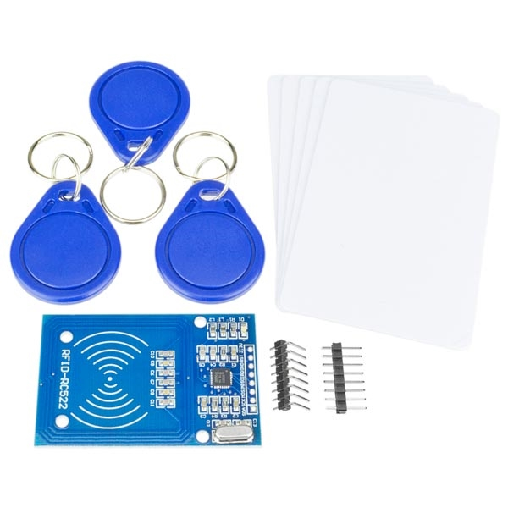
HARDWARE
RFID reader & cards

Slide 6
HARDWARE
ESP8266-12E module(Node MCU)
RFID Reader and Cards
OLED display
Basic board

Slide 7
SOFTWARE
Arduino IDE
Node Red
IBM Cloud platform
Cloudant Database

Slide 8
RFID TECHNOLOGY
RFID (Radio-Frequency Identification) technology is in mobile phones, credit cards, pet tracking chips, toll booths, and in tags for just about everything sold these days. Like many technologies used in consumer-end devices, RFID began as a military application.
There are two distinctly different types of RFID technology: passive and active.
A passive RFID system has an antenna and circuitry that houses a unique code, but has no power source. A passive RFID system requires a reader to induce current into the RFID tag’s circuitry, similar to how the German planes required radar to bounce off of them.
There are a variety of ranges and frequencies used for passive RFID, but the most common are:
Low frequency: ~125 kHz. Typically has a range of a few centimeters
High frequency: 13.56 MHz. Has a range of up to a meter
Ultra-high frequency: ~865 MHz. Has a range of about 30 meters
Passive RFID has a very short range, but they are still very popular because they are inexpensive and they last a long time without service.

Slide 9
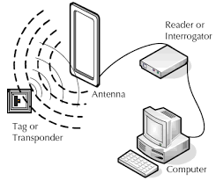
WORKING

Slide 10
Algorithm for the prepaid system:
1. Insert the smart card in the smart card slot.
2. Read the value on smart card.
3. Turn on the water supply with the help of servo motor.
4. When the units on smart card reaches below 500, turn off water supply .

Slide 11
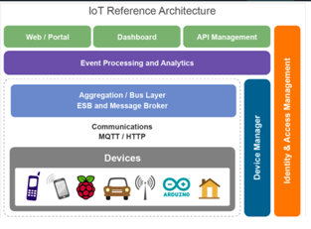

Slide 12
ADVANTAGES
Improved Customer Engagement
• Technology Optimization
• Reduced Waste
• Enhanced Data Collection

Slide 13
DISADVANTAGES
Security
• Privacy
• Complexity
• Flexibility
• Compliance

Slide 14
CONCLUSION
The system designed in this project can be implemented and used easily. As the system is user friendly it can be applicable for electricity and gas. In this paper the system has been used for one application. Further in future development the system can be implemented for more than one application such as electricity and gas supply in one smart card. Then the user can increase credit either on electricity, water or gas with the single smart card. The user can avoid the trouble for paying different bills every month and can save lot of time. Thus the system designed will be convenient for the users to plan their monthly expenses since the electricity; water and gas bills are already paid before using.

